Slide 1
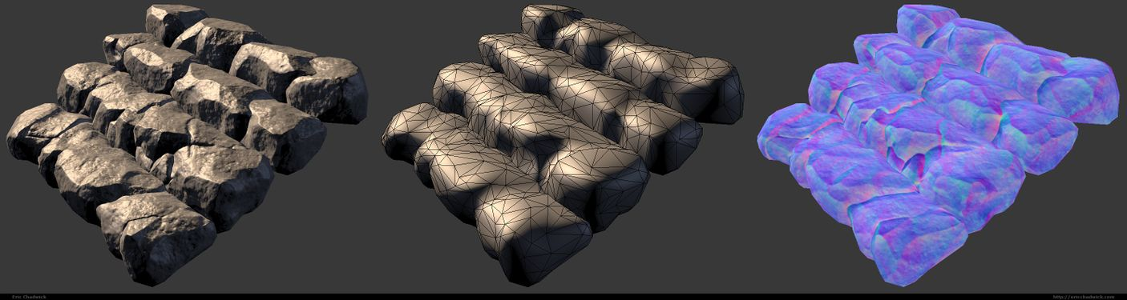
Texture Mapping
Part 2
Team Mayans

Slide 2
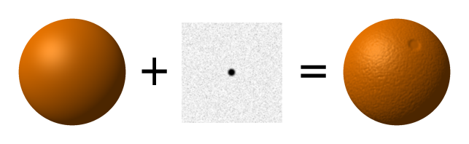
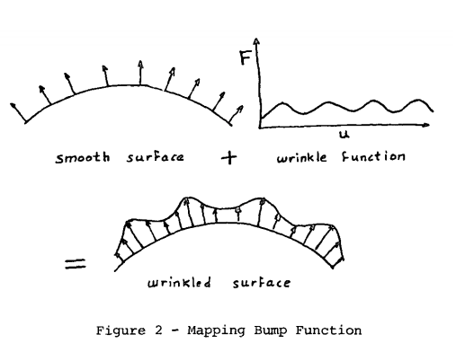
Bump Mapping

Slide 3
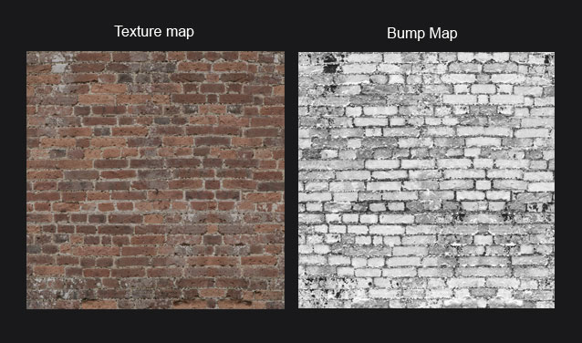

Slide 4
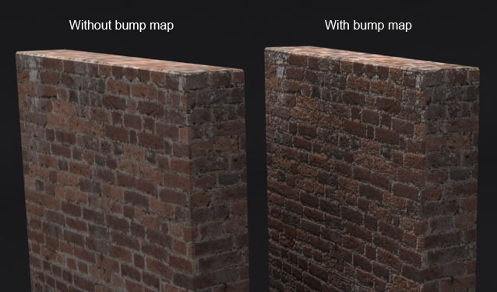

Slide 5
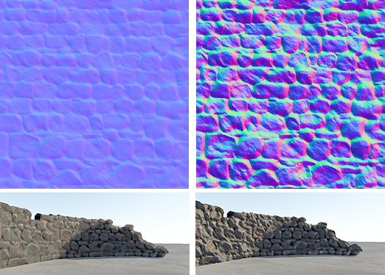
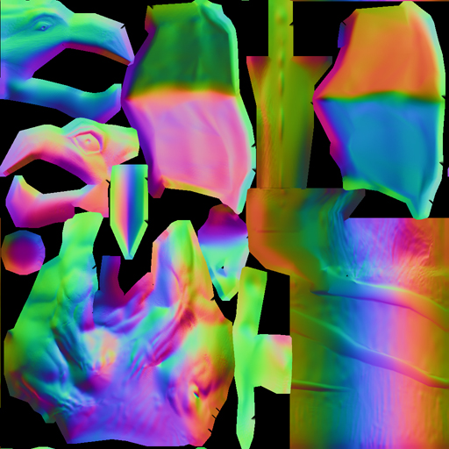
Normal Mapping
Tangent-Space Normal Map
Object-Space/World-Space Normal Map

Slide 6
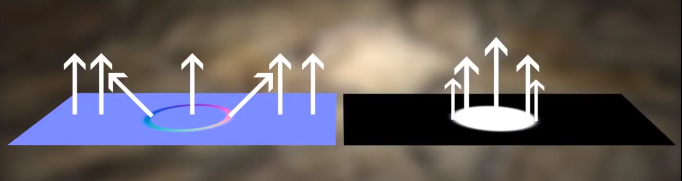
Normal Map versus Bump Map

Slide 7
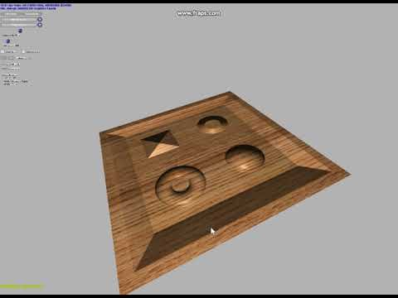

Slide 8
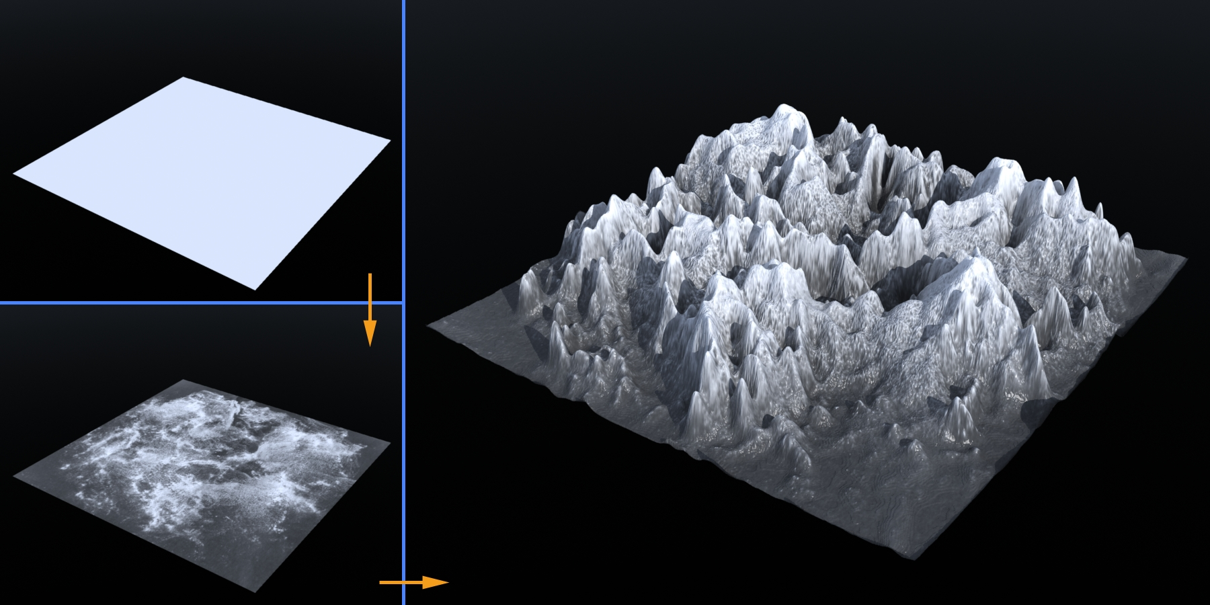
Displacement Mapping

Slide 9
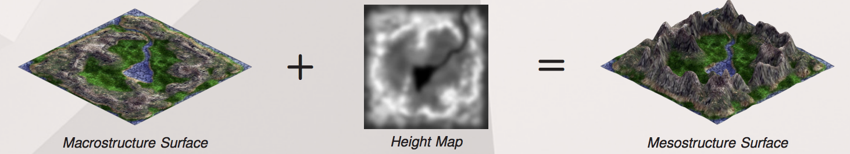
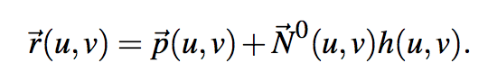

Slide 10
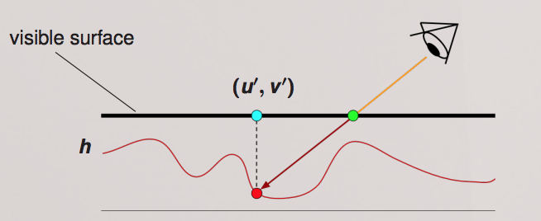
Per-pixel displacement mapping

Slide 11
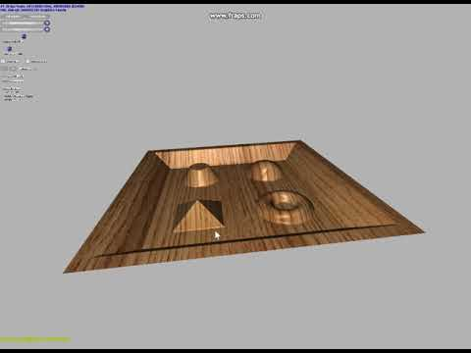

Slide 12
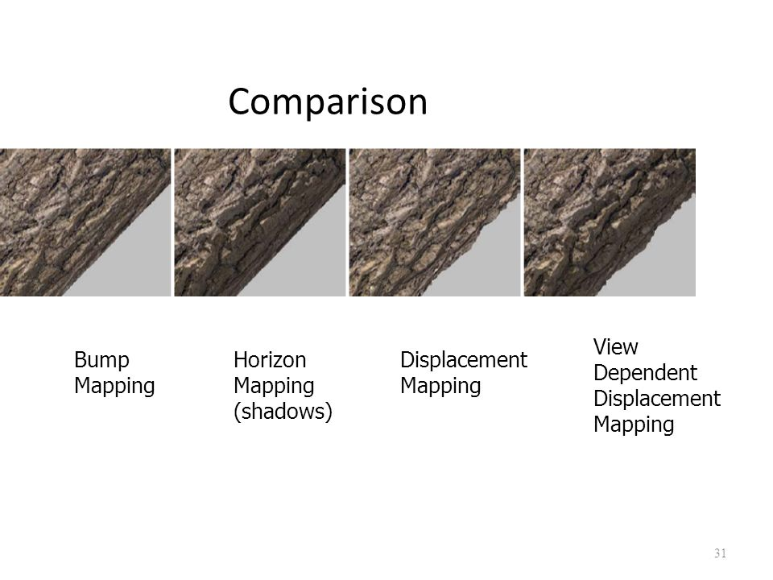
Horizon Mapping
Bump Mapping
Horizon Mapping (Shadows)
Displacement Mapping

Slide 13
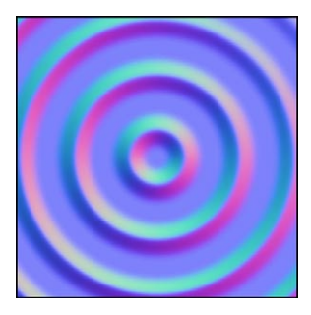
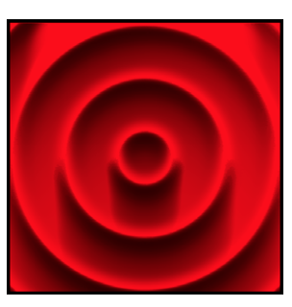

Horizon Mapping - Precomputing
Bump Mapping
Horizon Map
Basis Map

Slide 14
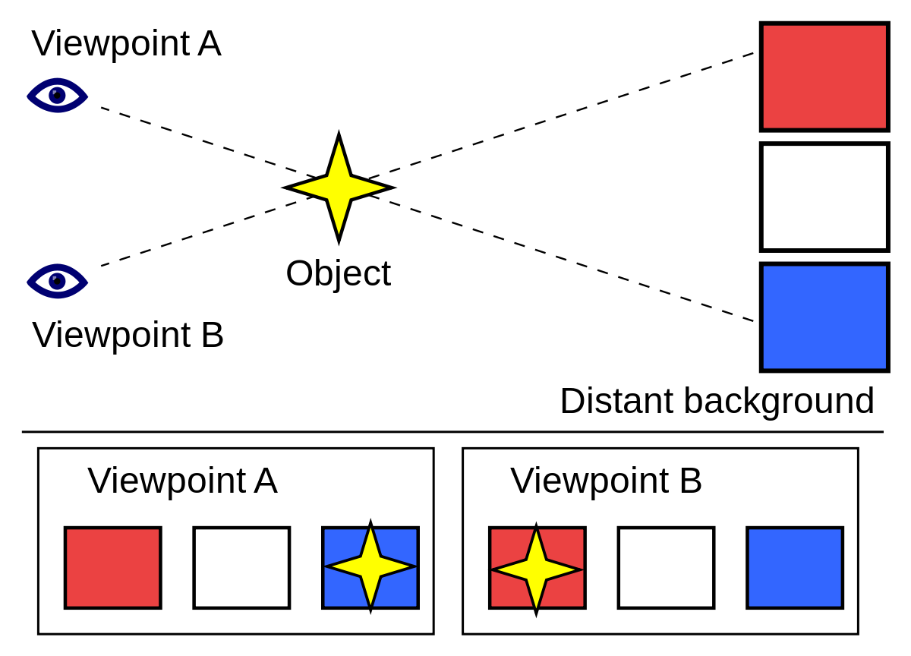

Slide 15
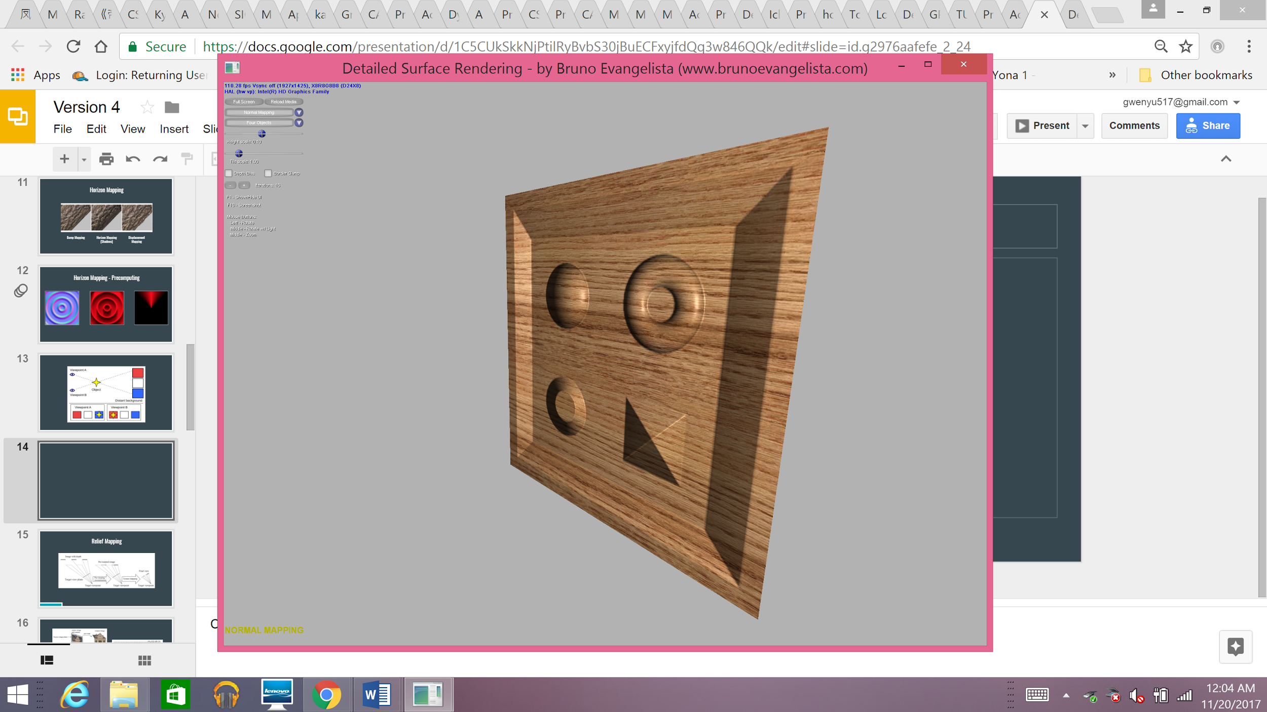
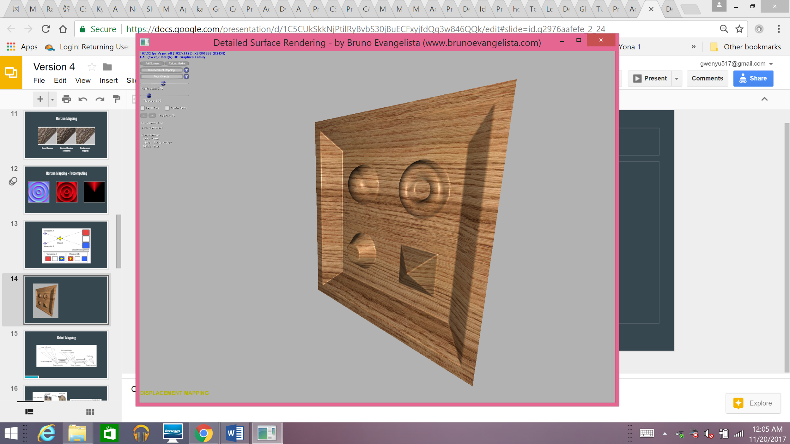
Normal Mapping
Displacement Mapping

Slide 16
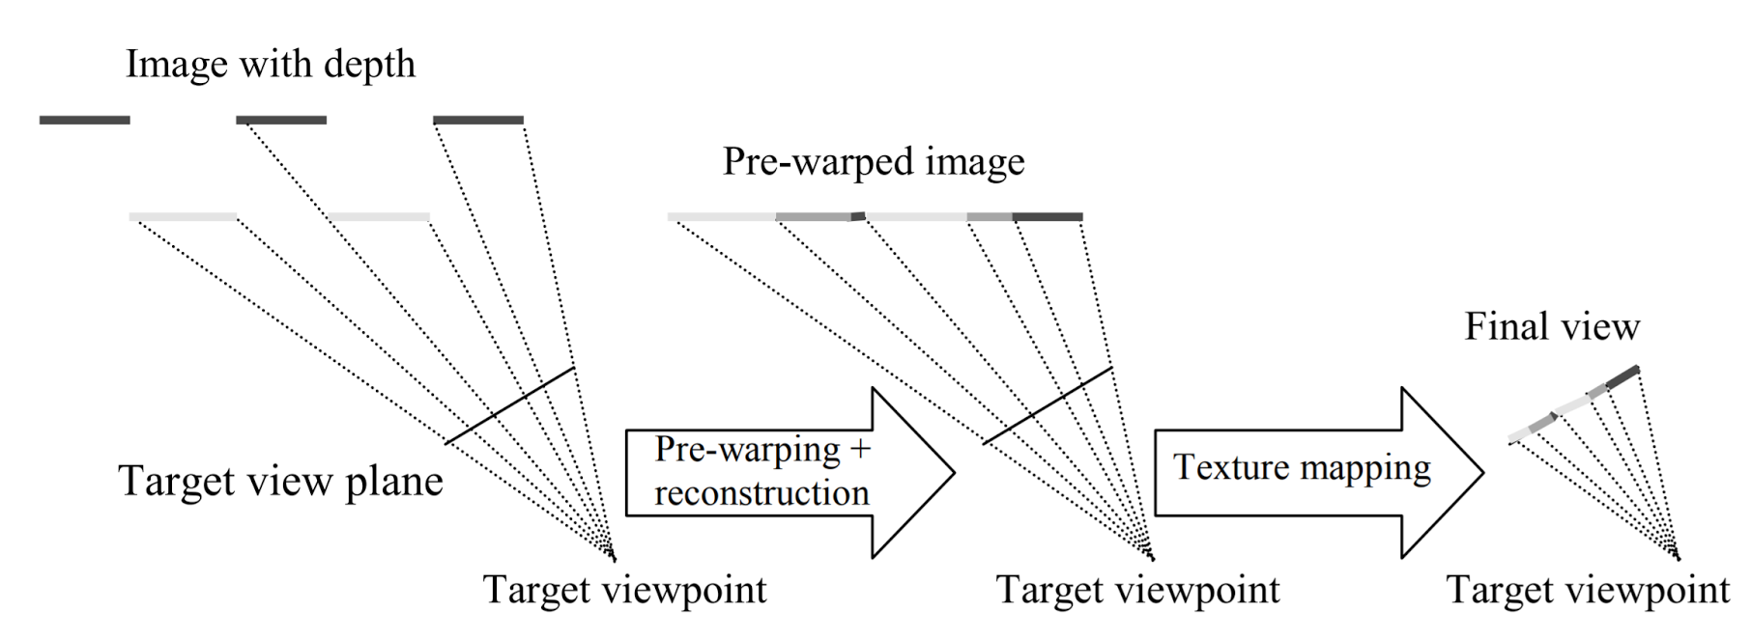
Relief Mapping

Slide 17
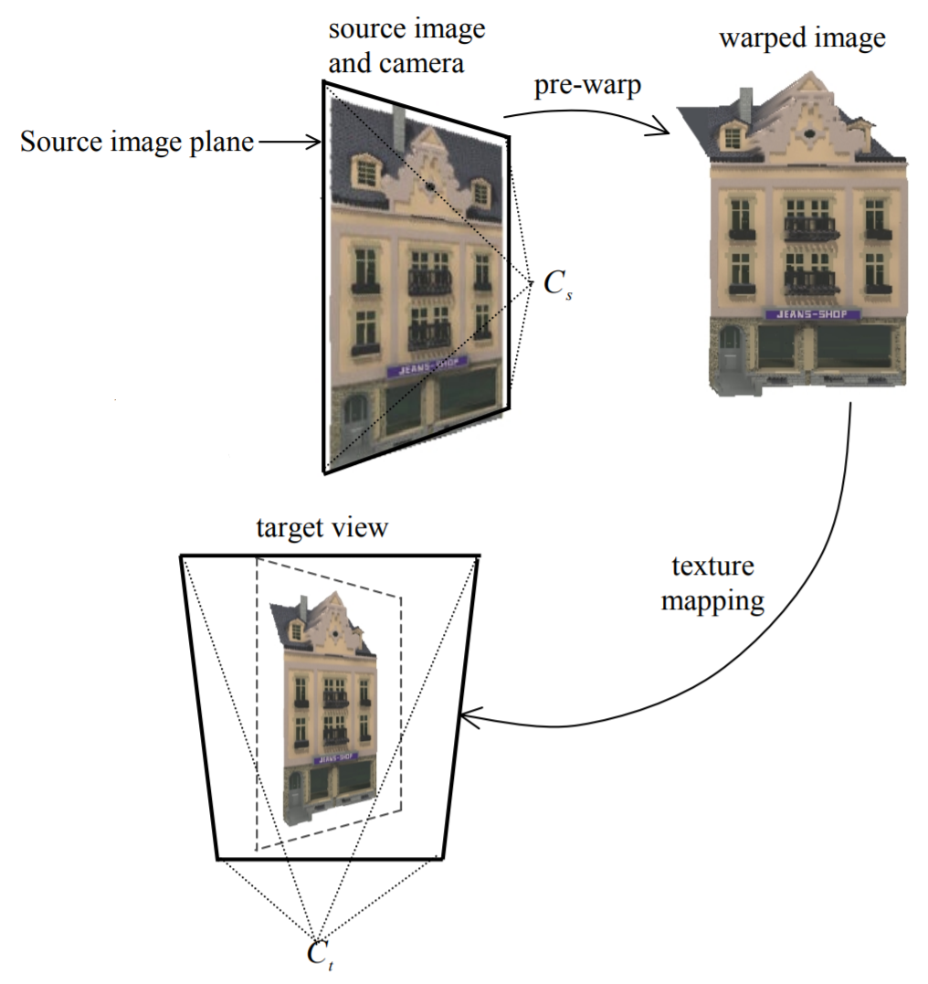
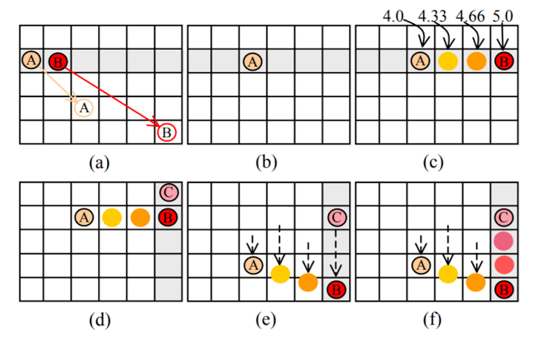

Slide 18
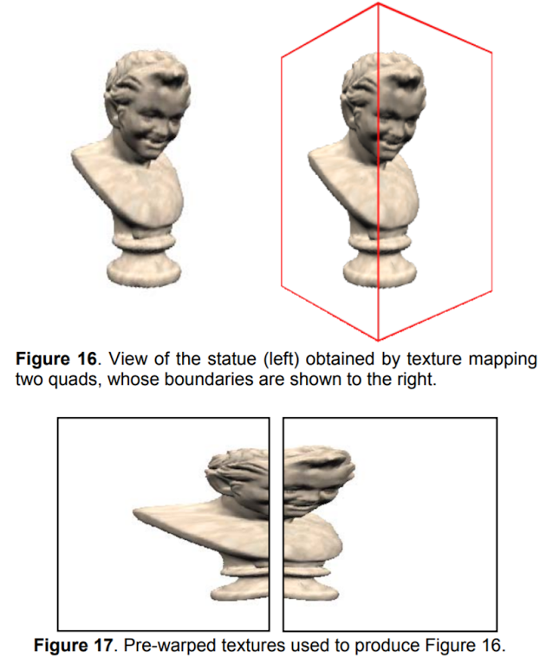

Slide 19
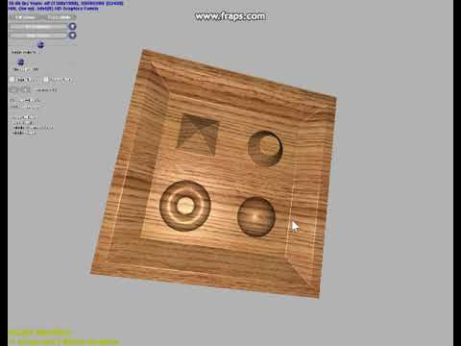

Slide 20
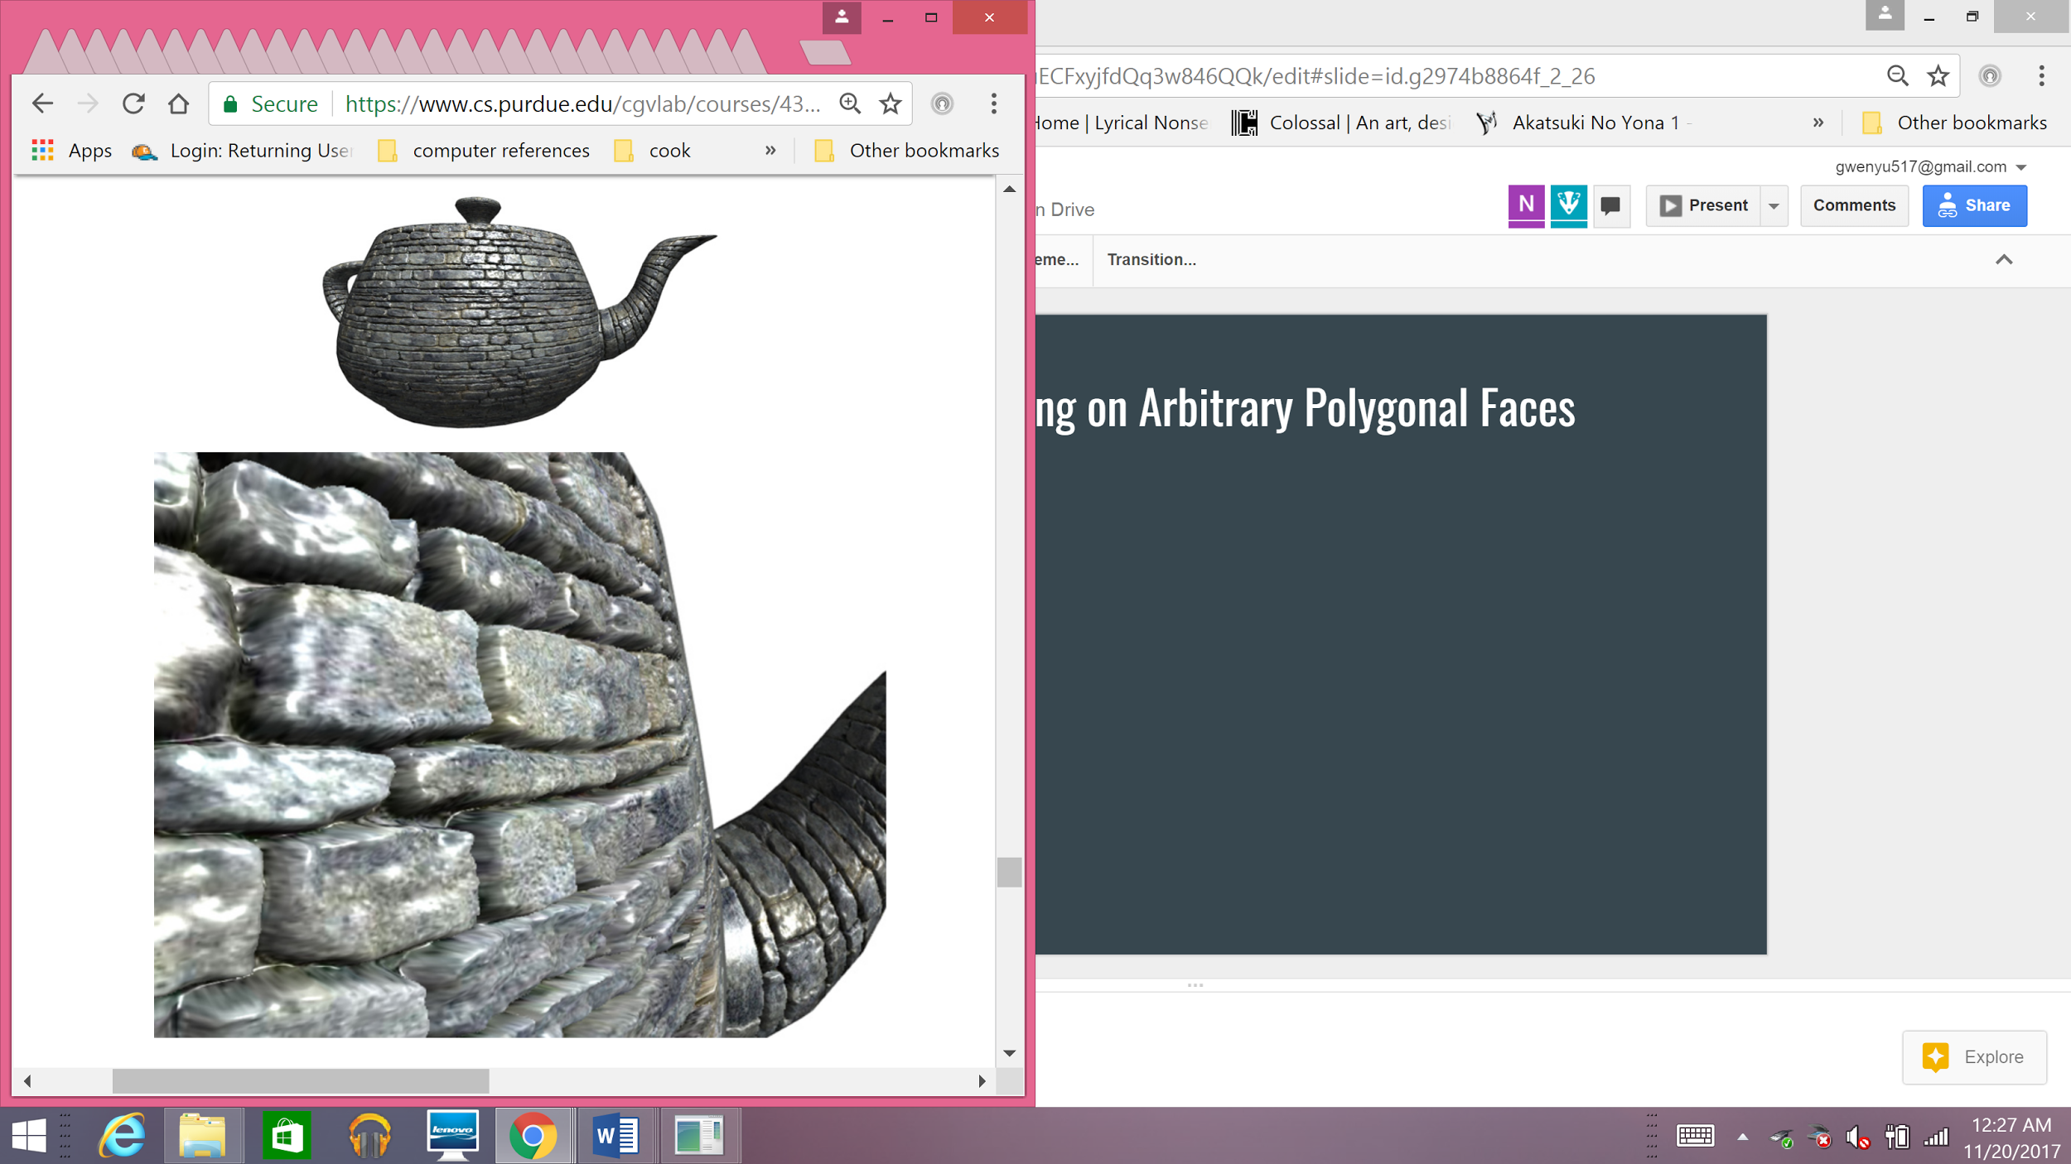
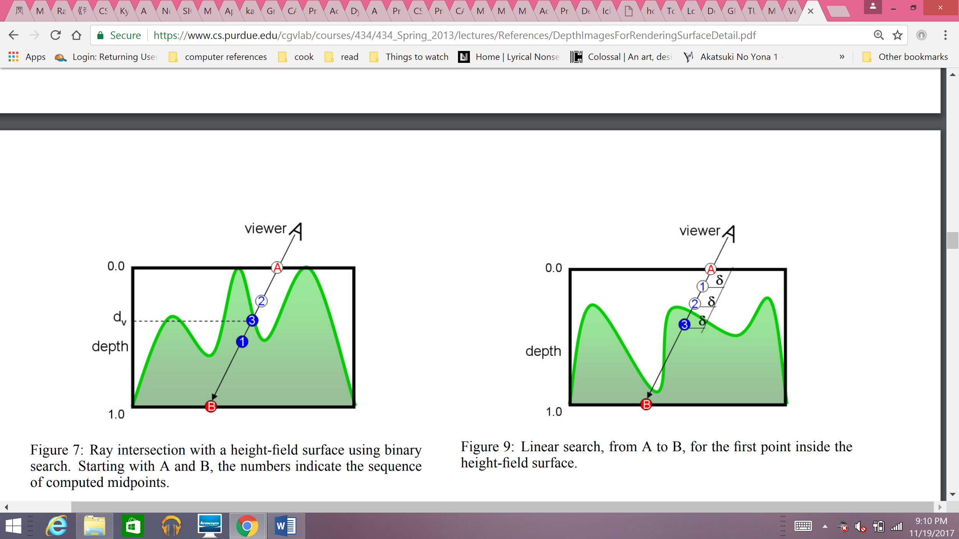
Relief Mapping on Arbitrary Polygonal Faces
Compute v from viewer to polygonal surface
Transform vector to tangent space (v’) associated with current fragment
Use the v’ and A to compute B.
Find intersection between v’ and height-field surface
Perform shading of fragment.

Slide 21
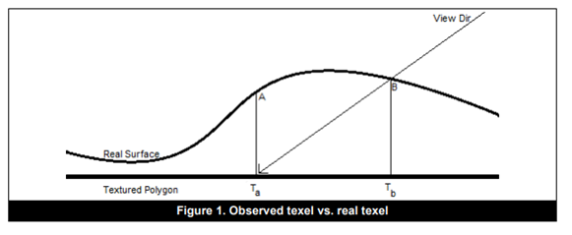
Parallax Occlusion Mapping

Slide 22
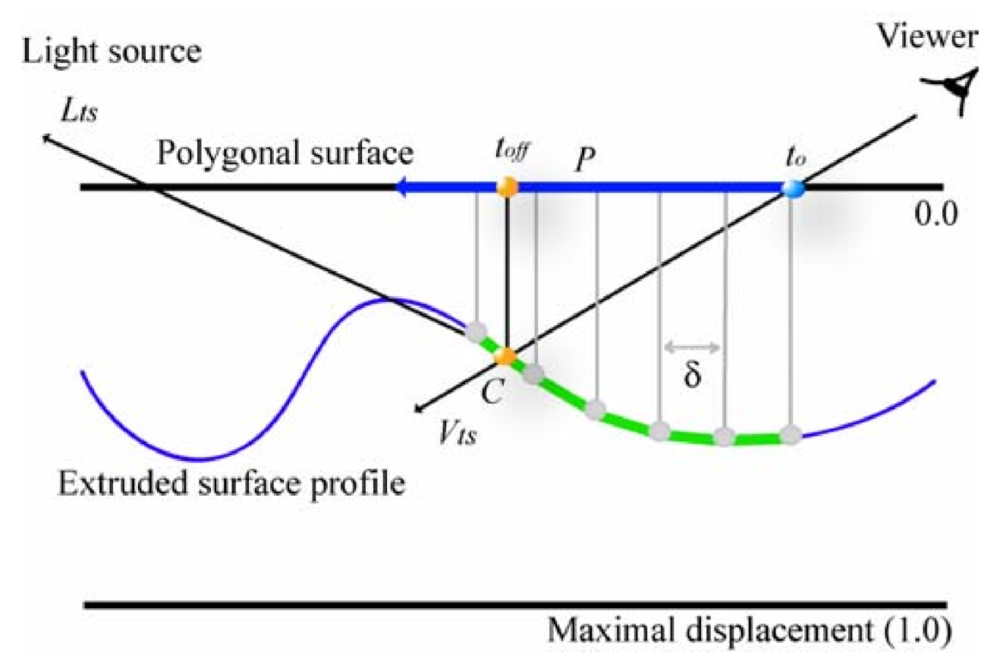
Compute V_{ts} and L_{ts}
Ray cast V_{ts} along P to compute height profile-ray intersection point
Find texture coordinate offset/parallax offset for t_{off}
Estimate light visibility coefficient v
Shade pixel using v, L_{ts} and pixel attributes sampled at t_{off}

Slide 23
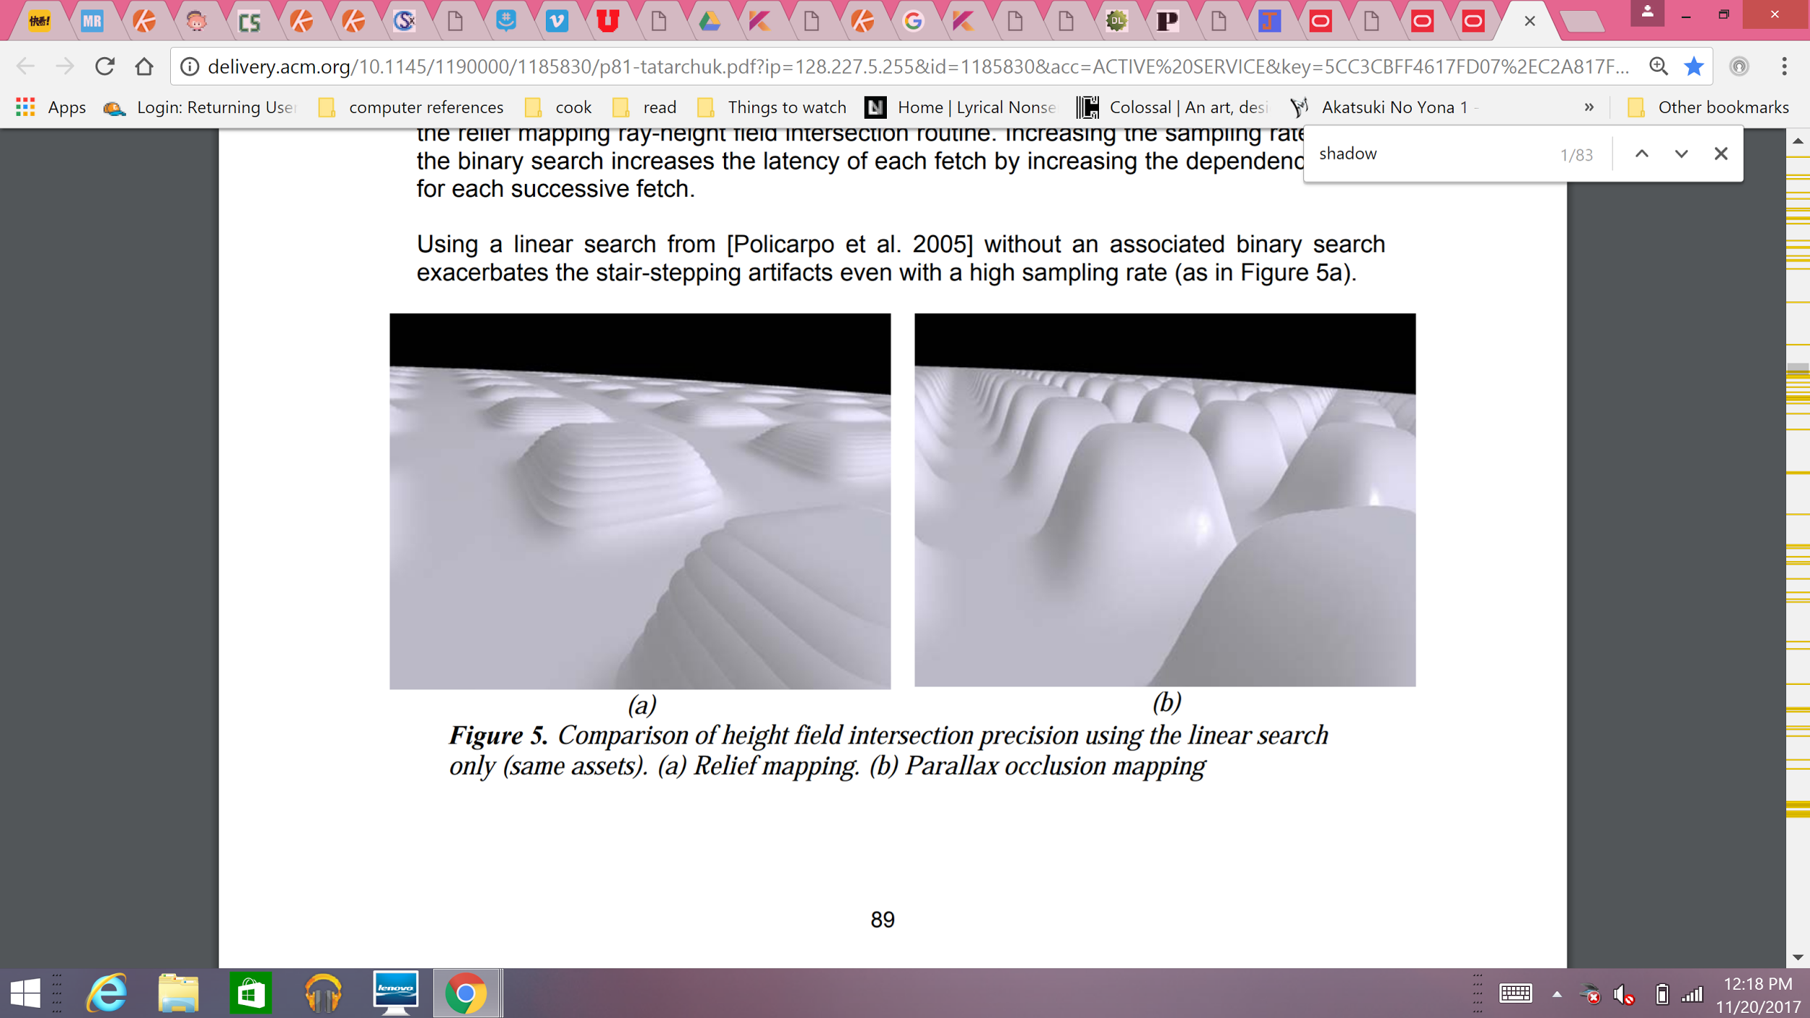
Relief mapping using linear search only.
POM using high precision height field intersection computation.

Slide 24
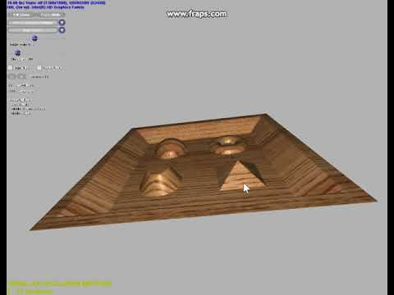

Slide 25
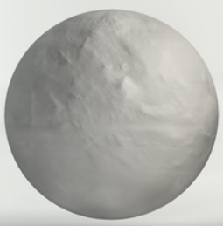
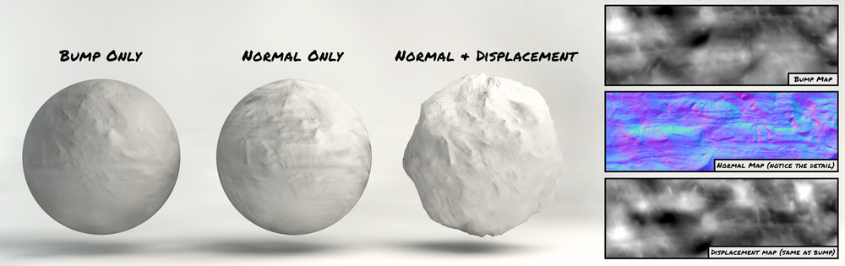
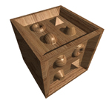
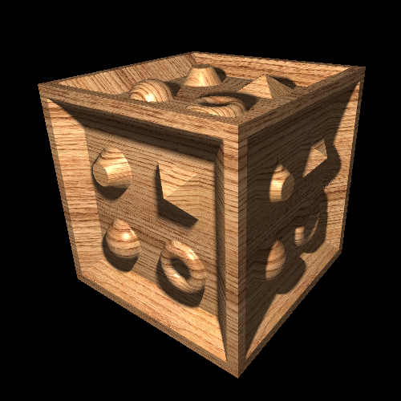
Bump | Normal | Displacement | Horizon | Relief | Parallax Occlusion
Surface normal vector perturbation | Surface normals of a 3D object as R, G, B color values | Physically displaces the geometric position of vertices along the surface normal vector | Creates shadows on bump maps | Image warping, then texture mapping | Height field sampling for position offset
Low cost | Medium cost | Very-High cost | Medium - High cost | High cost | Variable cost
No extra geometry | No extra geometry | Changes geometry | No extra geometry | No extra geometry | No extra geometry
Notes:
Bump mapping - Illusion of high geometric complexity, no extra geometry
Normal mapping - no extra geometry
Displacement - - generates additional geometry/ adds physical geometry
Relief - requires multiple images for different views
Parallax occlusion - only needs a color map, normal map, and height map

Slide 26
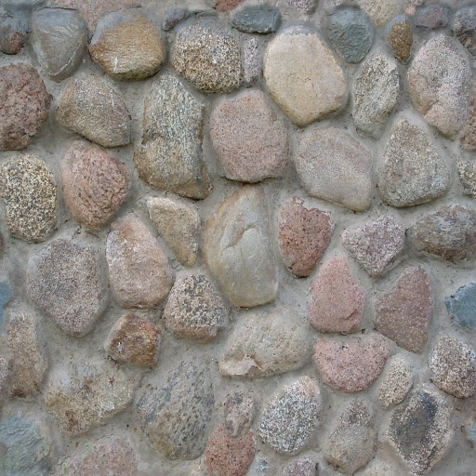
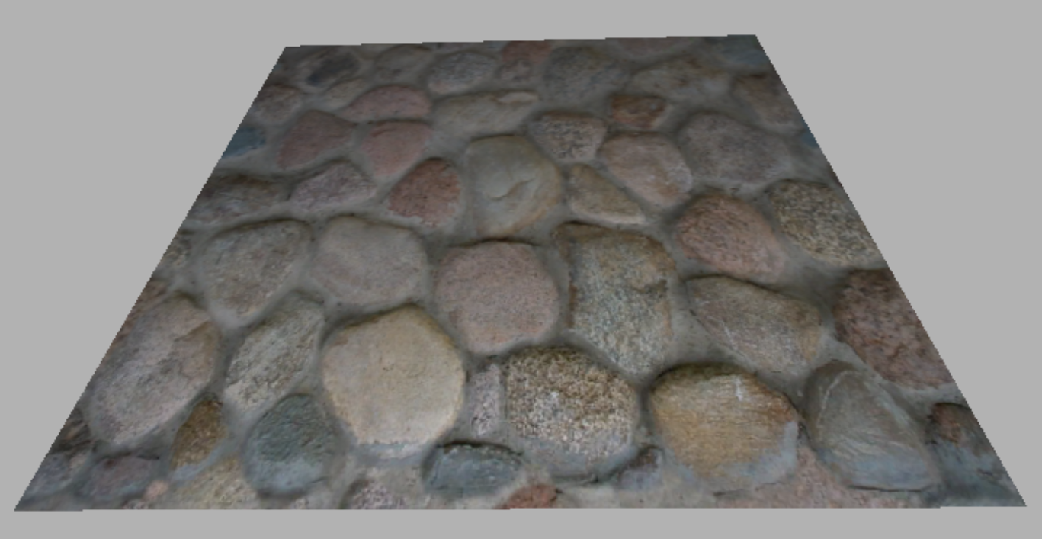
Original Image

Slide 27
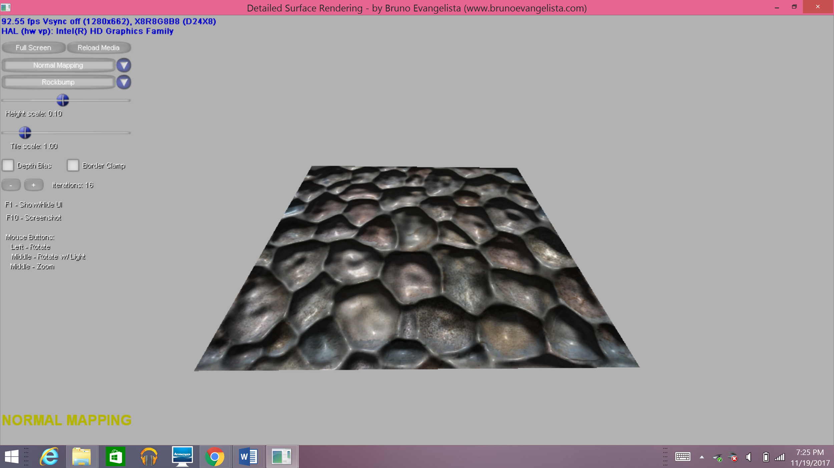
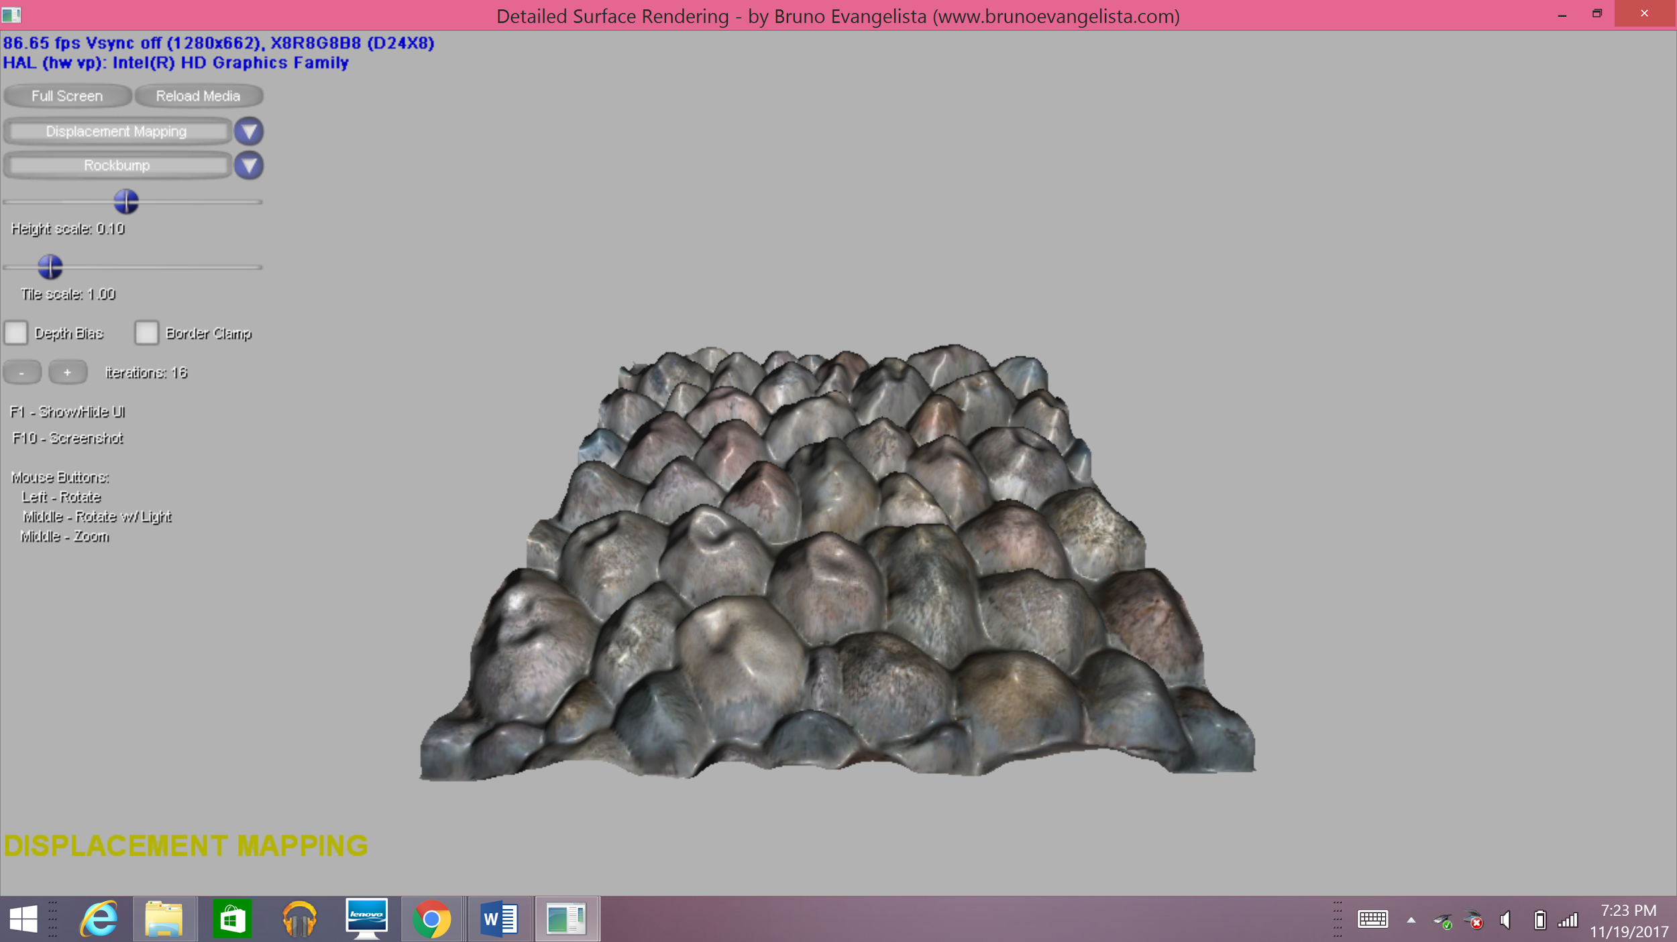
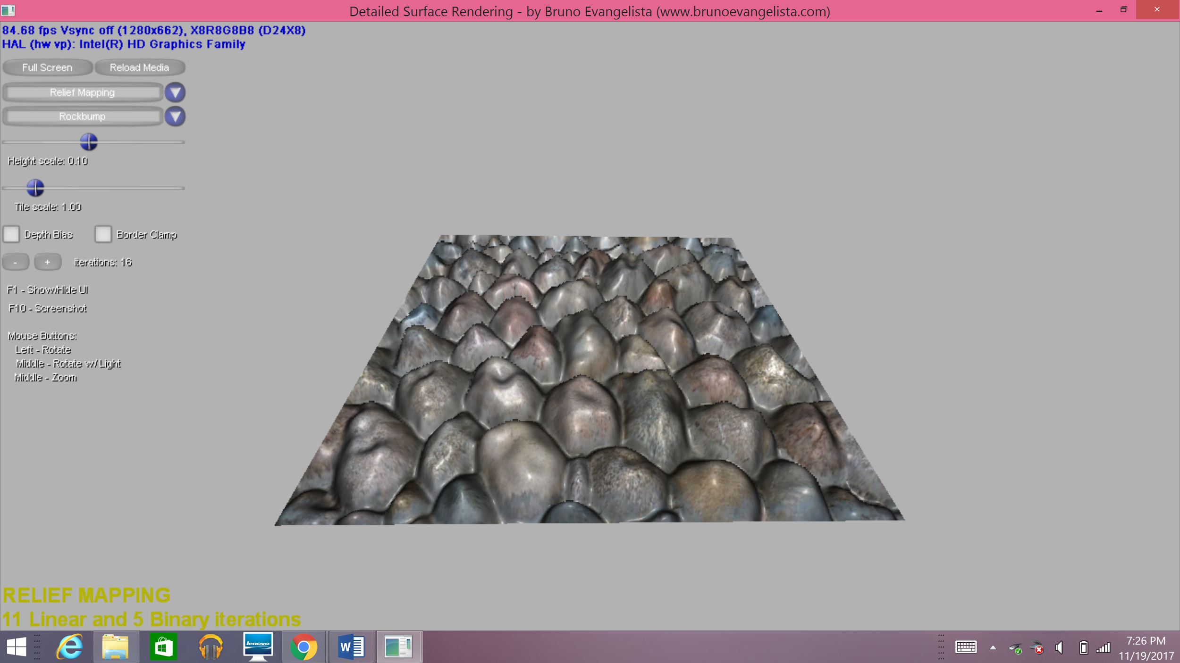
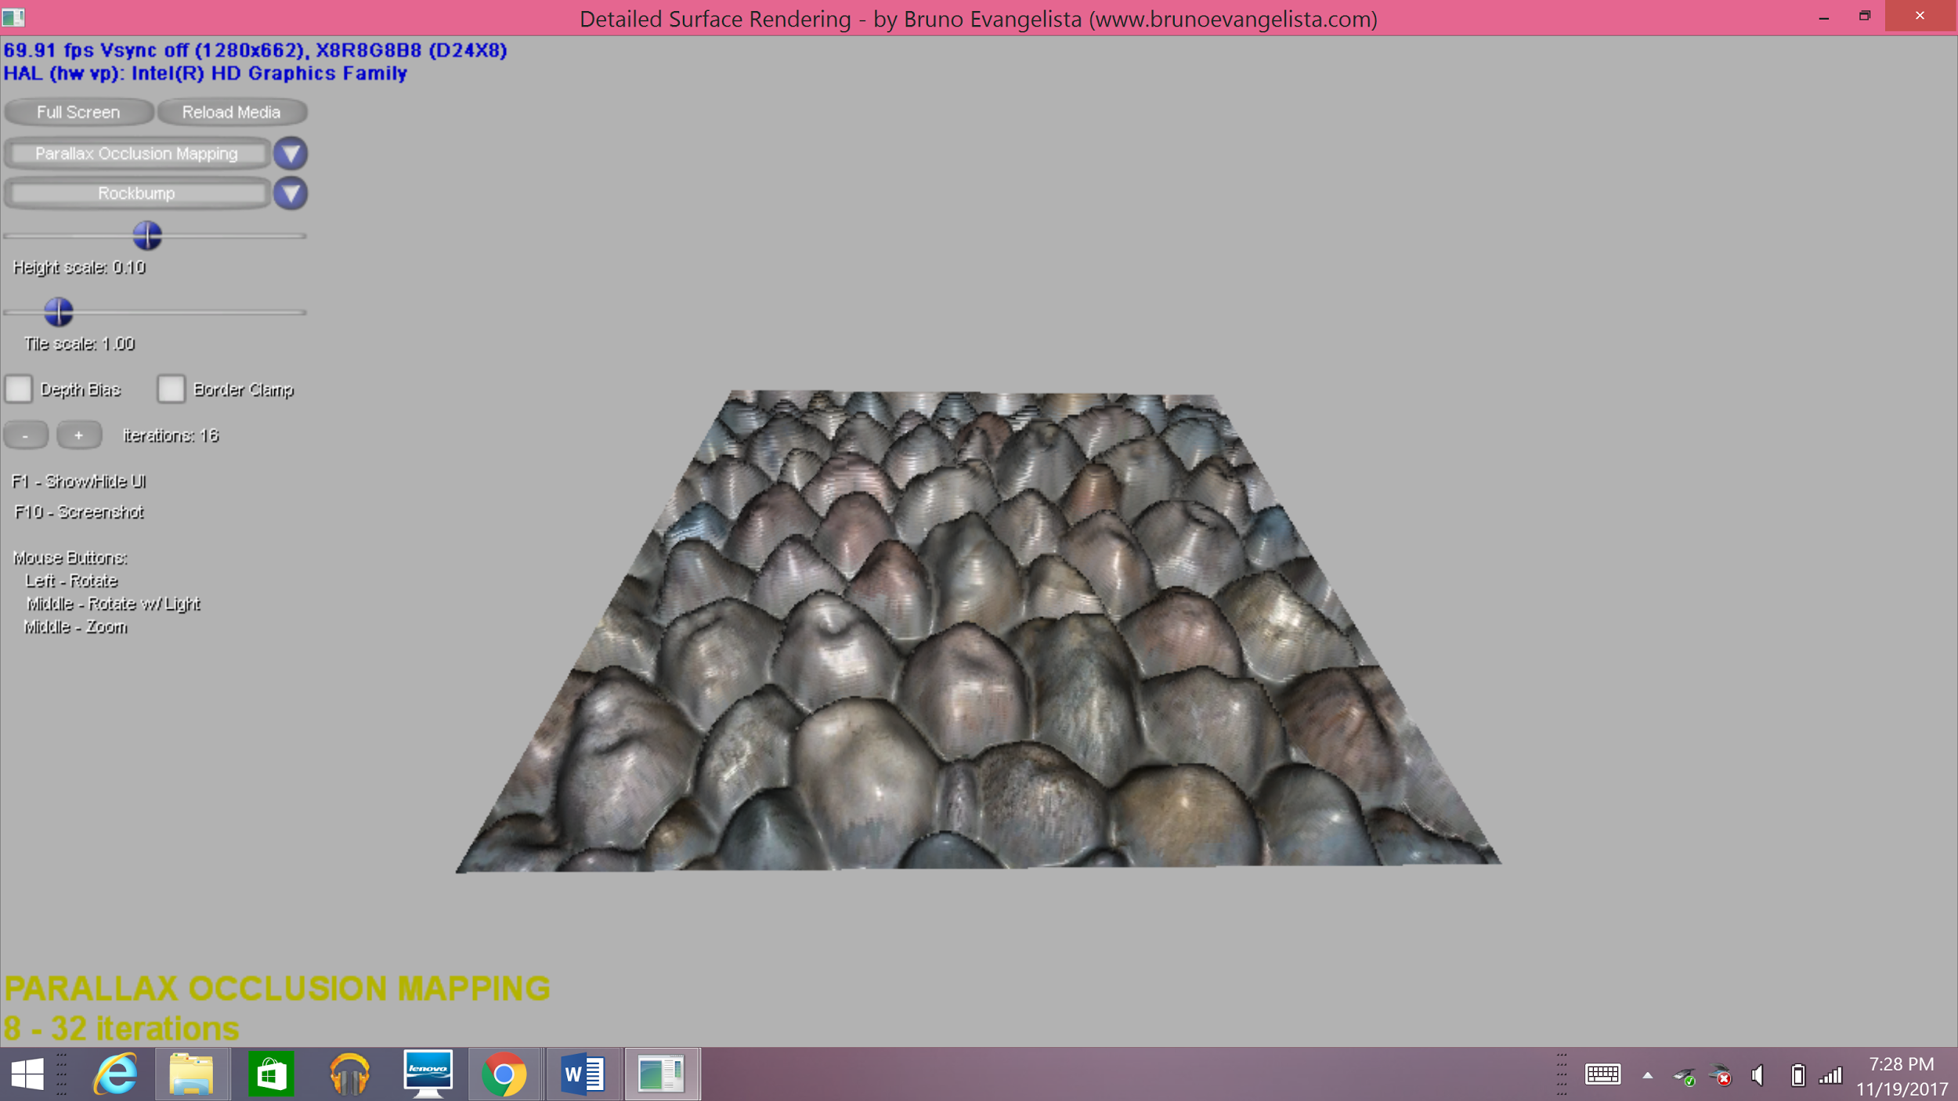
Normal Mapping
Displacement Mapping
Relief Mapping
Parallax Occlusion Mapping
Notes:
Bump mapping - Illusion of high geometric complexity, no extra geometry
Normal mapping - no extra geometry
Displacement - - generates additional geometry/ adds physical geometry
Relief - requires multiple images for different views
Parallax occlusion - only needs a color map, normal map, and height map

Slide 28
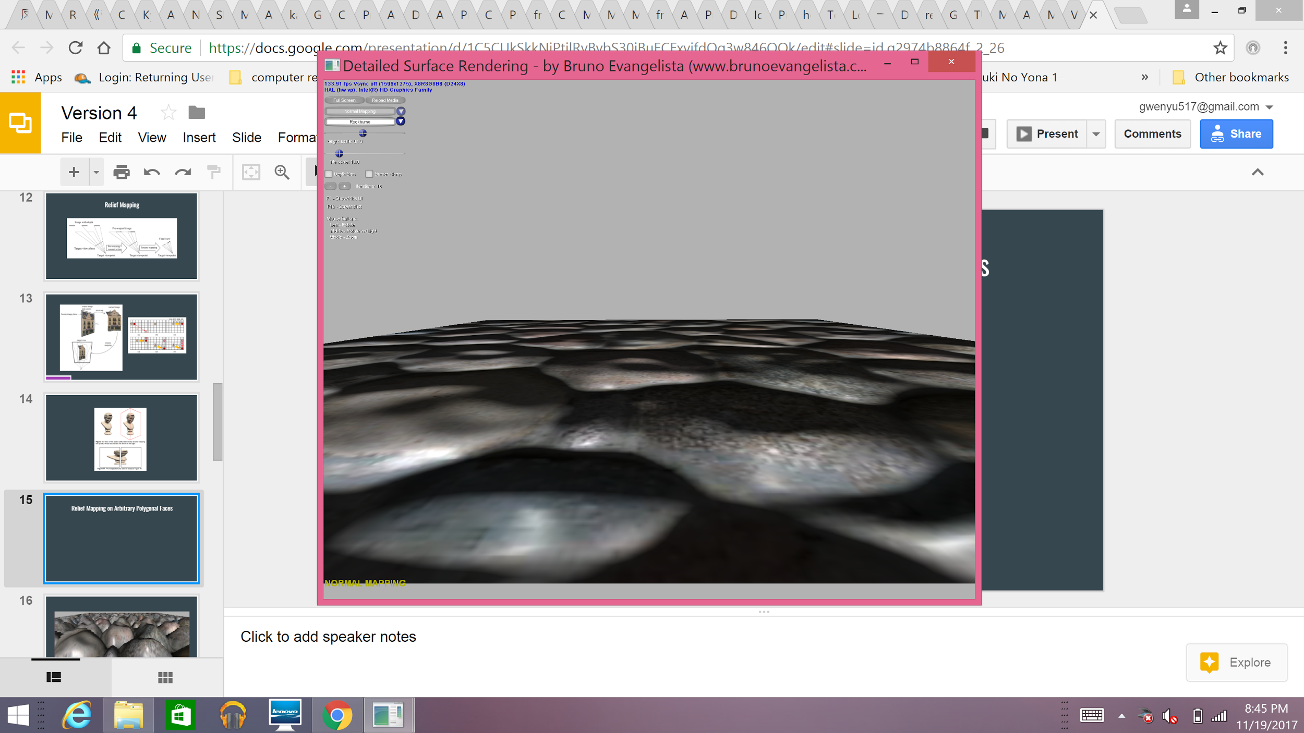
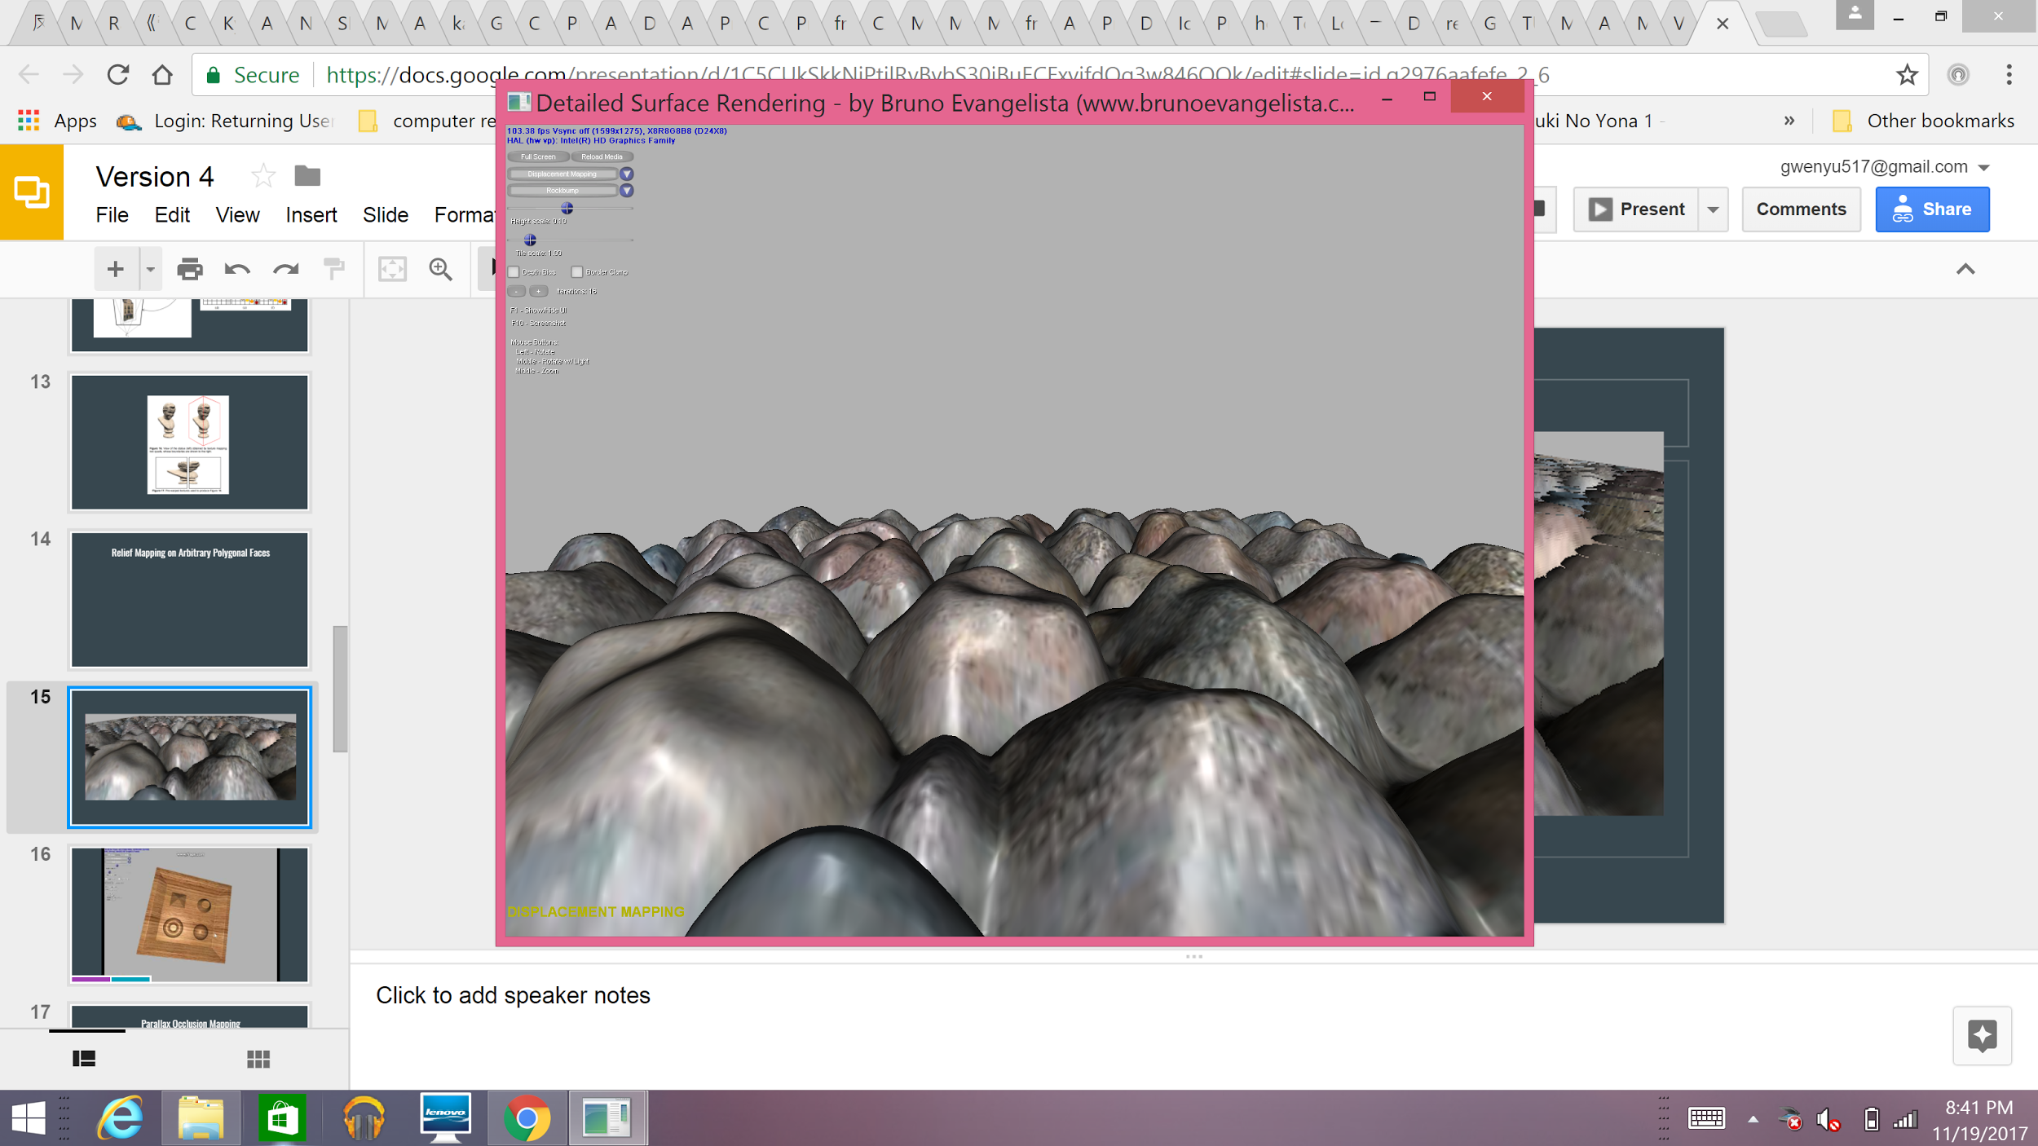
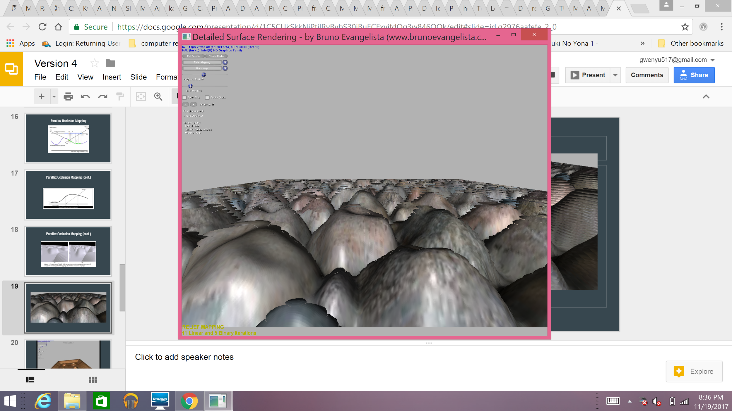
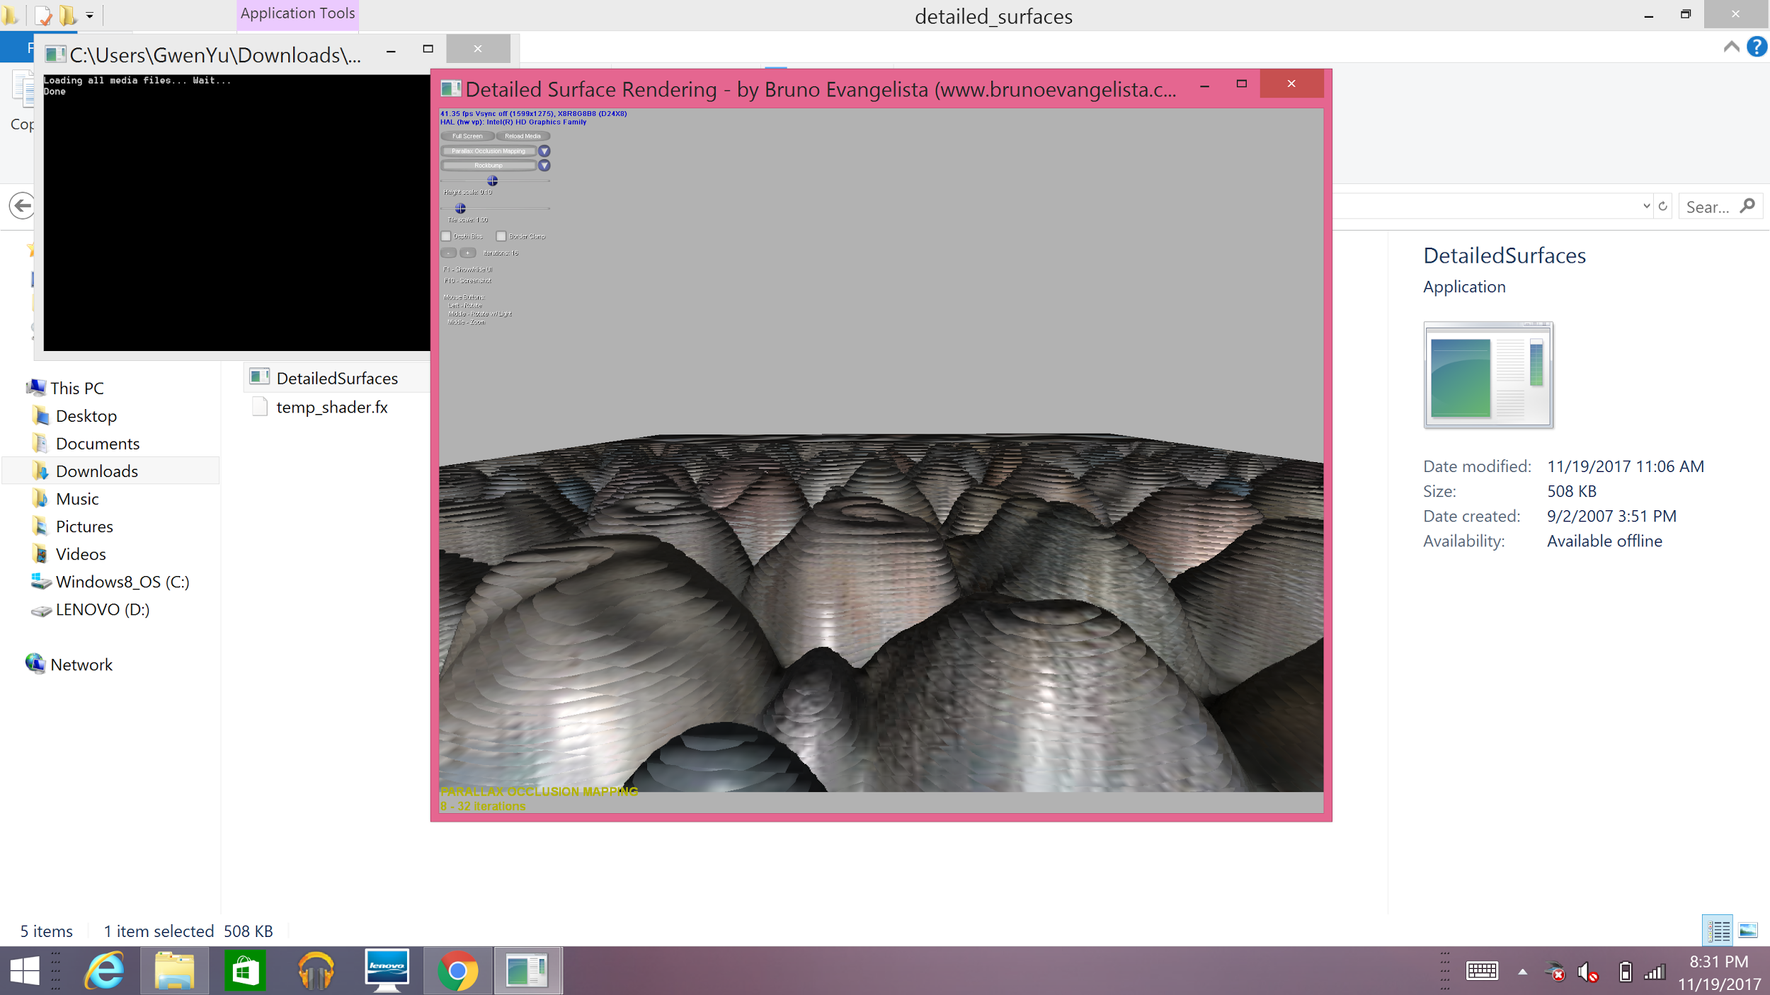
Normal Mapping
Displacement Mapping
Relief Mapping
Parallax Occlusion Mapping

Slide 29
Image Sources
Video & comparison images source
Works Cited
http://wiki.polycount.com/wiki/Normal_map
http://3dmodeling4business.com/wp-content/uploads/2012/10/Bump-Map-2.jpg
http://www.alejandrosegovia.net/wp-content/uploads/2014/03/Bump-Map.jpg
https://www.microsoft.com/en-us/research/wp-content/uploads/1978/01/p286-blinn.pdf
https://docs.unity3d.com/uploads/Main/BumpMapLowAndHighBumpiness.png
https://upload.wikimedia.org/wikipedia/commons/3/36/Displacement_Mapping.jpg
http://www.cs.utah.edu/~sujin/courses/reports/cs6610/project-report/images/pom.png
http://www.inf.ufrgs.br/~oliveira/pubs_files//cube_RM.jpg
http://www.visionday.dk/VD17/posters/submitted_posters/RiccardoLogginiVisionDayPoster.pdf
http://slideplayer.com/slide/3431816/12/images/31/Comparison+View+Dependent+Displacement+Mapping+Bump+Mapping+Horizon.jpg
Detailed Surfaces Viewer by Bruno Evangelista ( http://www.brunoevangelista.com/projects/ )
See https://gwenyu517.github.io/CAP3027_TeamMayans/references.html

